Slide 1
Lecture 3: Market Equilibrium

Slide 2
Balance of Demand and Supply
Market equilibrium signifies a balance between two opposing forces:
As defined in earlier sessions;
Demand:
The quantity of goods or services that consumers are willing and able to buy at a given price level.
Supply:
The quantity of goods or services that producers are willing and able to offer for sale at the same price level.

Slide 3
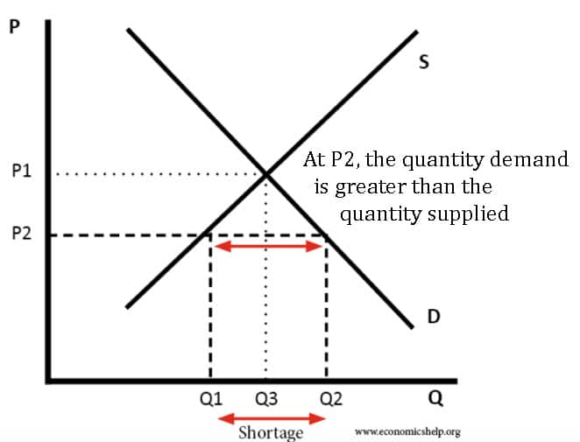
Excess Demand (Shortage)

Slide 4
Excess Supply (Surplus)
Excess supply, also known as a surplus, occurs when the quantity supplied by producers exceeds the quantity demanded by consumers at a specific price.
In this scenario, there is an oversupply of goods in the market, which can lead to downward pressure on prices.

Slide 5
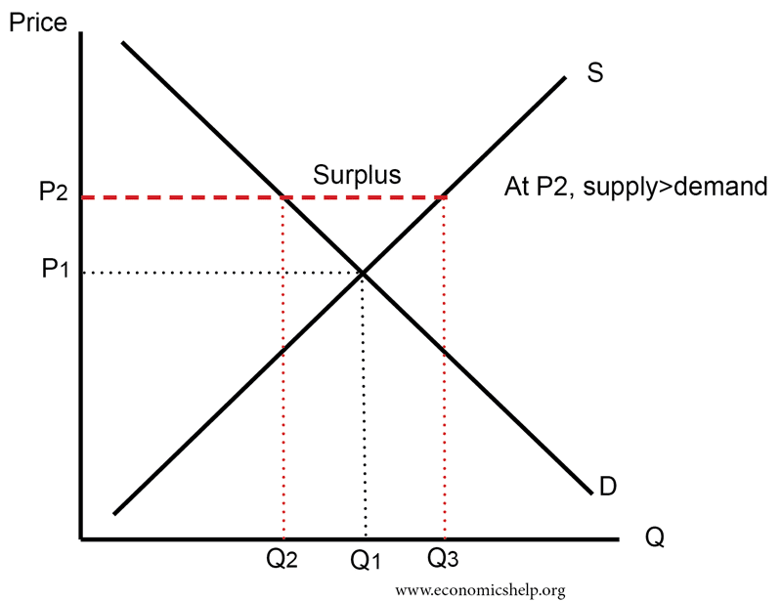
Excess Supply (Surplus)

Slide 6
Effects of Changes in Demand and Supply on Market Equilibrium
Changes in demand and supply can shift the market equilibrium, leading to new price and quantity levels.
Increase in Demand:
If demand increases, the demand curve shifts to the right, causing a new market equilibrium with a higher price and quantity.
Decrease in Demand:
If demand decreases, the demand curve shifts to the left, resulting in a new market equilibrium with a lower price and quantity.

Slide 7
Effects of Changes in Demand and Supply on Market Equilibrium
Increase in Supply:
If supply increases, the supply curve shifts to the right, leading to a new market equilibrium with a lower price and higher quantity.
Decrease in Supply:
If supply decreases, the supply curve shifts to the left, resulting in a new market equilibrium with a higher price and lower quantity.

Slide 8
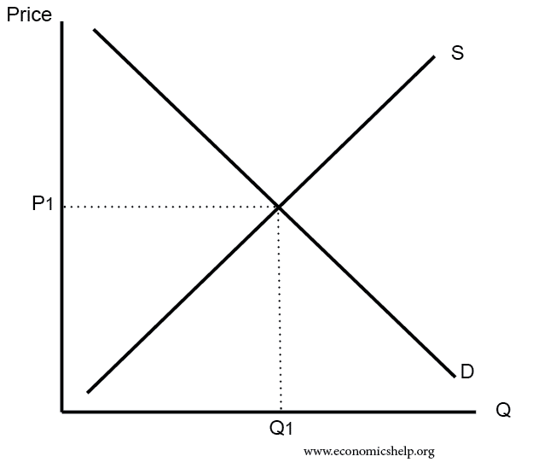
Diagrammatic Representation of Market Equilibrium

Slide 9
Importance of Market Equilibrium in VCA
Understanding market equilibrium is crucial for value chain agriculture students because it:
Determines Prices: Market equilibrium determines the market price at which agricultural goods are bought and sold, impacting the income of producers and affordability for consumers.
Helps in Decision Making: Analyzing market equilibrium assists value chain actors in making informed decisions regarding production levels and resource allocation.
Balances Supply and Demand: Market equilibrium ensures that there is no surplus or shortage, fostering stability in the agricultural market.

Slide 10
Exercise: Market Equilibrium
Consider the market for tomatoes in Malawi. At a price of MK 200 per kilogram, the quantity demanded is 1,000 kilograms, and the quantity supplied is 800 kilograms. Is there a shortage or surplus in the market? If so, calculate the magnitude of the shortage or surplus.
Suppose the demand for maize increases due to an increase in population and consumer preferences. Explain how this change in demand would affect the market equilibrium in the maize industry. Draw a diagram to illustrate the new equilibrium price and quantity
The government implements a subsidy program to support small-scale dairy farmers. As a result, the supply of milk increases in the market. Describe the impact of this subsidy on the market equilibrium for dairy products. How would the equilibrium price and quantity change?
In the market for fish, the quantity demanded is given by the equation Qd = 500 - 2P, while the quantity supplied is given by the equation Qs = 100 + 3P, where P is the price per kilogram of fish. Determine the market equilibrium price and quantity of fish.

Slide 11
Case Study: The Market for Organic Vegetables
The market for organic vegetables in Malawi has been growing steadily due to increasing consumer awareness of health and environmental benefits. Organic vegetable producers face higher production costs due to the use of organic farming methods. At the same time, consumers are willing to pay a premium for organic produce.
Suppose the market for organic vegetables is initially in equilibrium, with a price of MK 500 per kilogram and a quantity of 2,000 kilograms sold per week. However, due to a surge in demand for organic vegetables, the quantity demanded increases to 2,500 kilograms at the same price
Analyze the impact of this increase in demand on the market equilibrium. Is there a shortage or surplus in the market? Calculate the magnitude of the shortage or surplus.
How might organic vegetable producers respond to this increase in demand? Discuss possible strategies they could adopt to meet the higher demand.
In the long run, if more farmers enter the organic vegetable market, how would this affect the market equilibrium? Consider both supply and demand factors.

